Slide 1
THE LEARNING WALK
A Learning Walk can be an excellent way for governors to engage children in conversation to discover their thoughts and opinions about their school environment as well as how successfully it challenges and inspires them in their learning.
The following questions are not all followed by the word ‘why?’. However, governors will be looking for more than single word responses, so will want to enquire appropriately about reasons and examples with regard to the answers given.
Four key areas in the school are focused on in the presentation – the outside environment, a spiritual /quiet garden, prayer stations and interactive displays which support the teaching of Christian values.

Slide 2
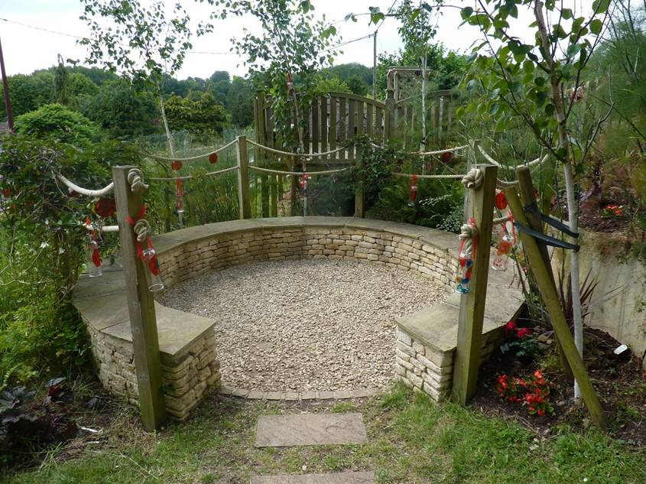
The Outside Environment
Where in the school grounds do you most like to go at break or lunchtime?
Which is your favourite outside space and why?
Which is your least favourite outside space and why?

Slide 3
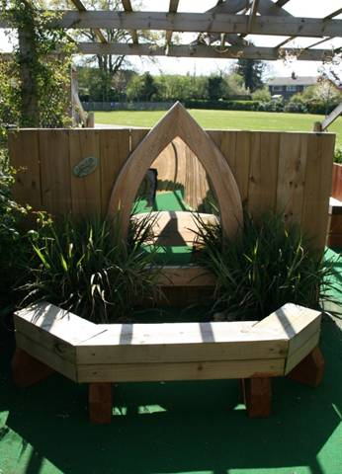
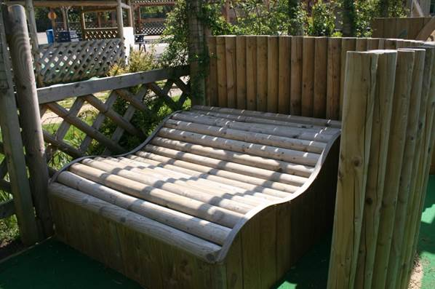
Where would you go if you wanted to be quiet or pray?

Slide 4
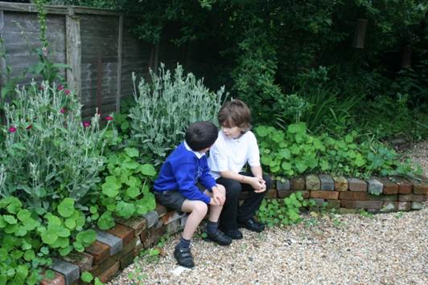
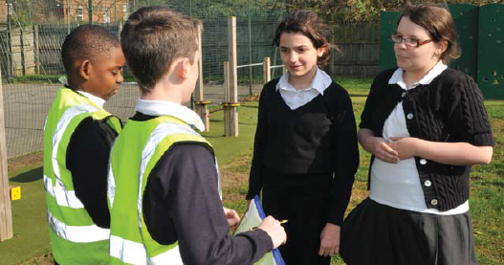
If you had a problem at break or lunchtime, where would you go and who would you talk to?

Slide 5
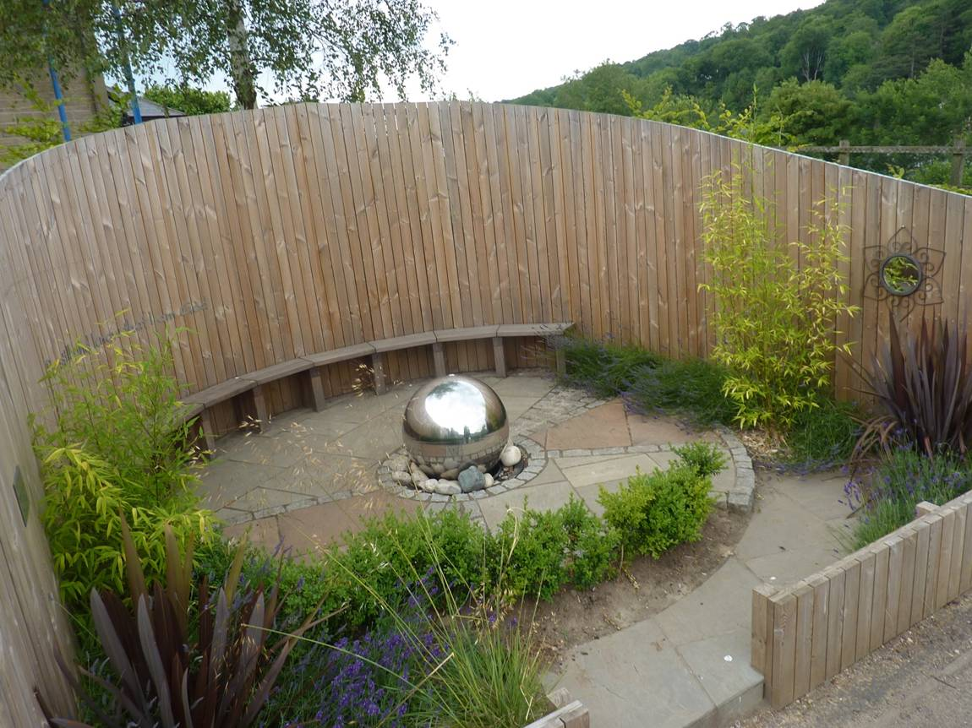
Take me to your favourite parts of the school. On the way, tell me why you enjoy these places.

Slide 6
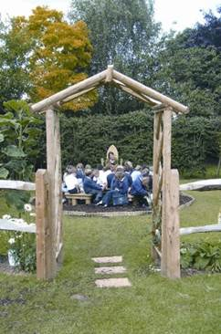
A Spiritual or Quiet Garden
Why does your school have this garden?
What makes this place special?

Slide 7
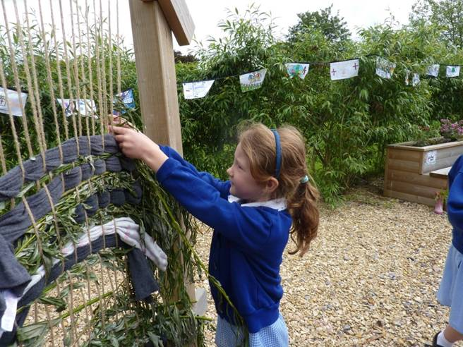
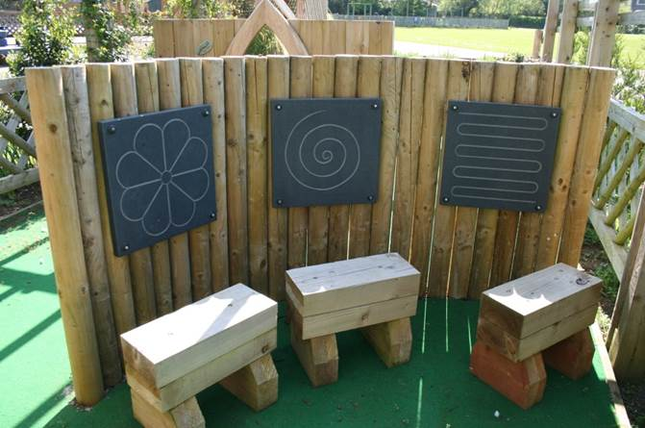
How is the garden used by different children and adults?

Slide 8
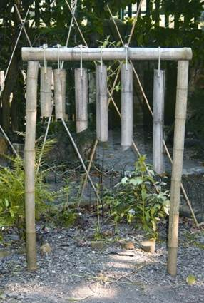
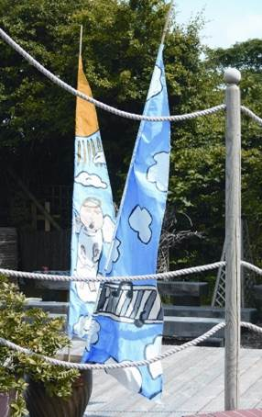
What would you miss if your school did not have a spiritual garden?

Slide 9
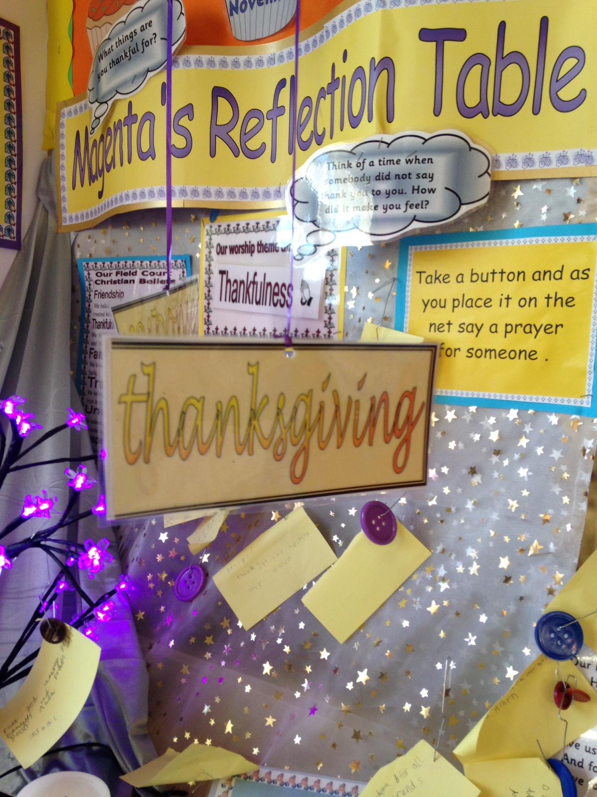
The Inside Environment
Do you think it is a good idea to have prayer stations like this one around the school?
How would you use this prayer station?

Slide 10
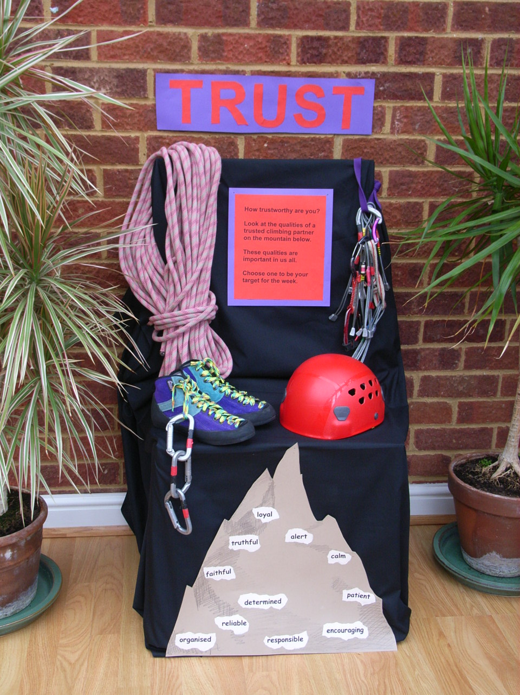
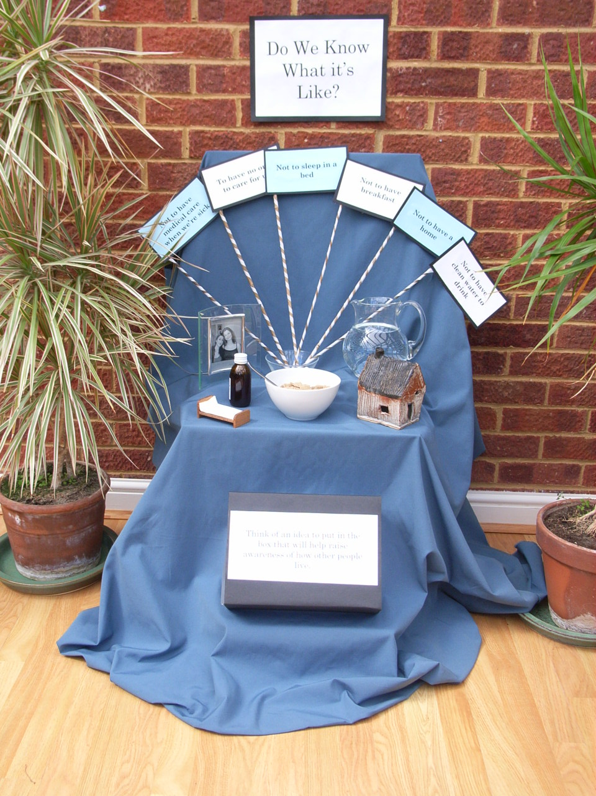
Do you think this prayer station helps people to talk to God?
In what way?

Slide 11
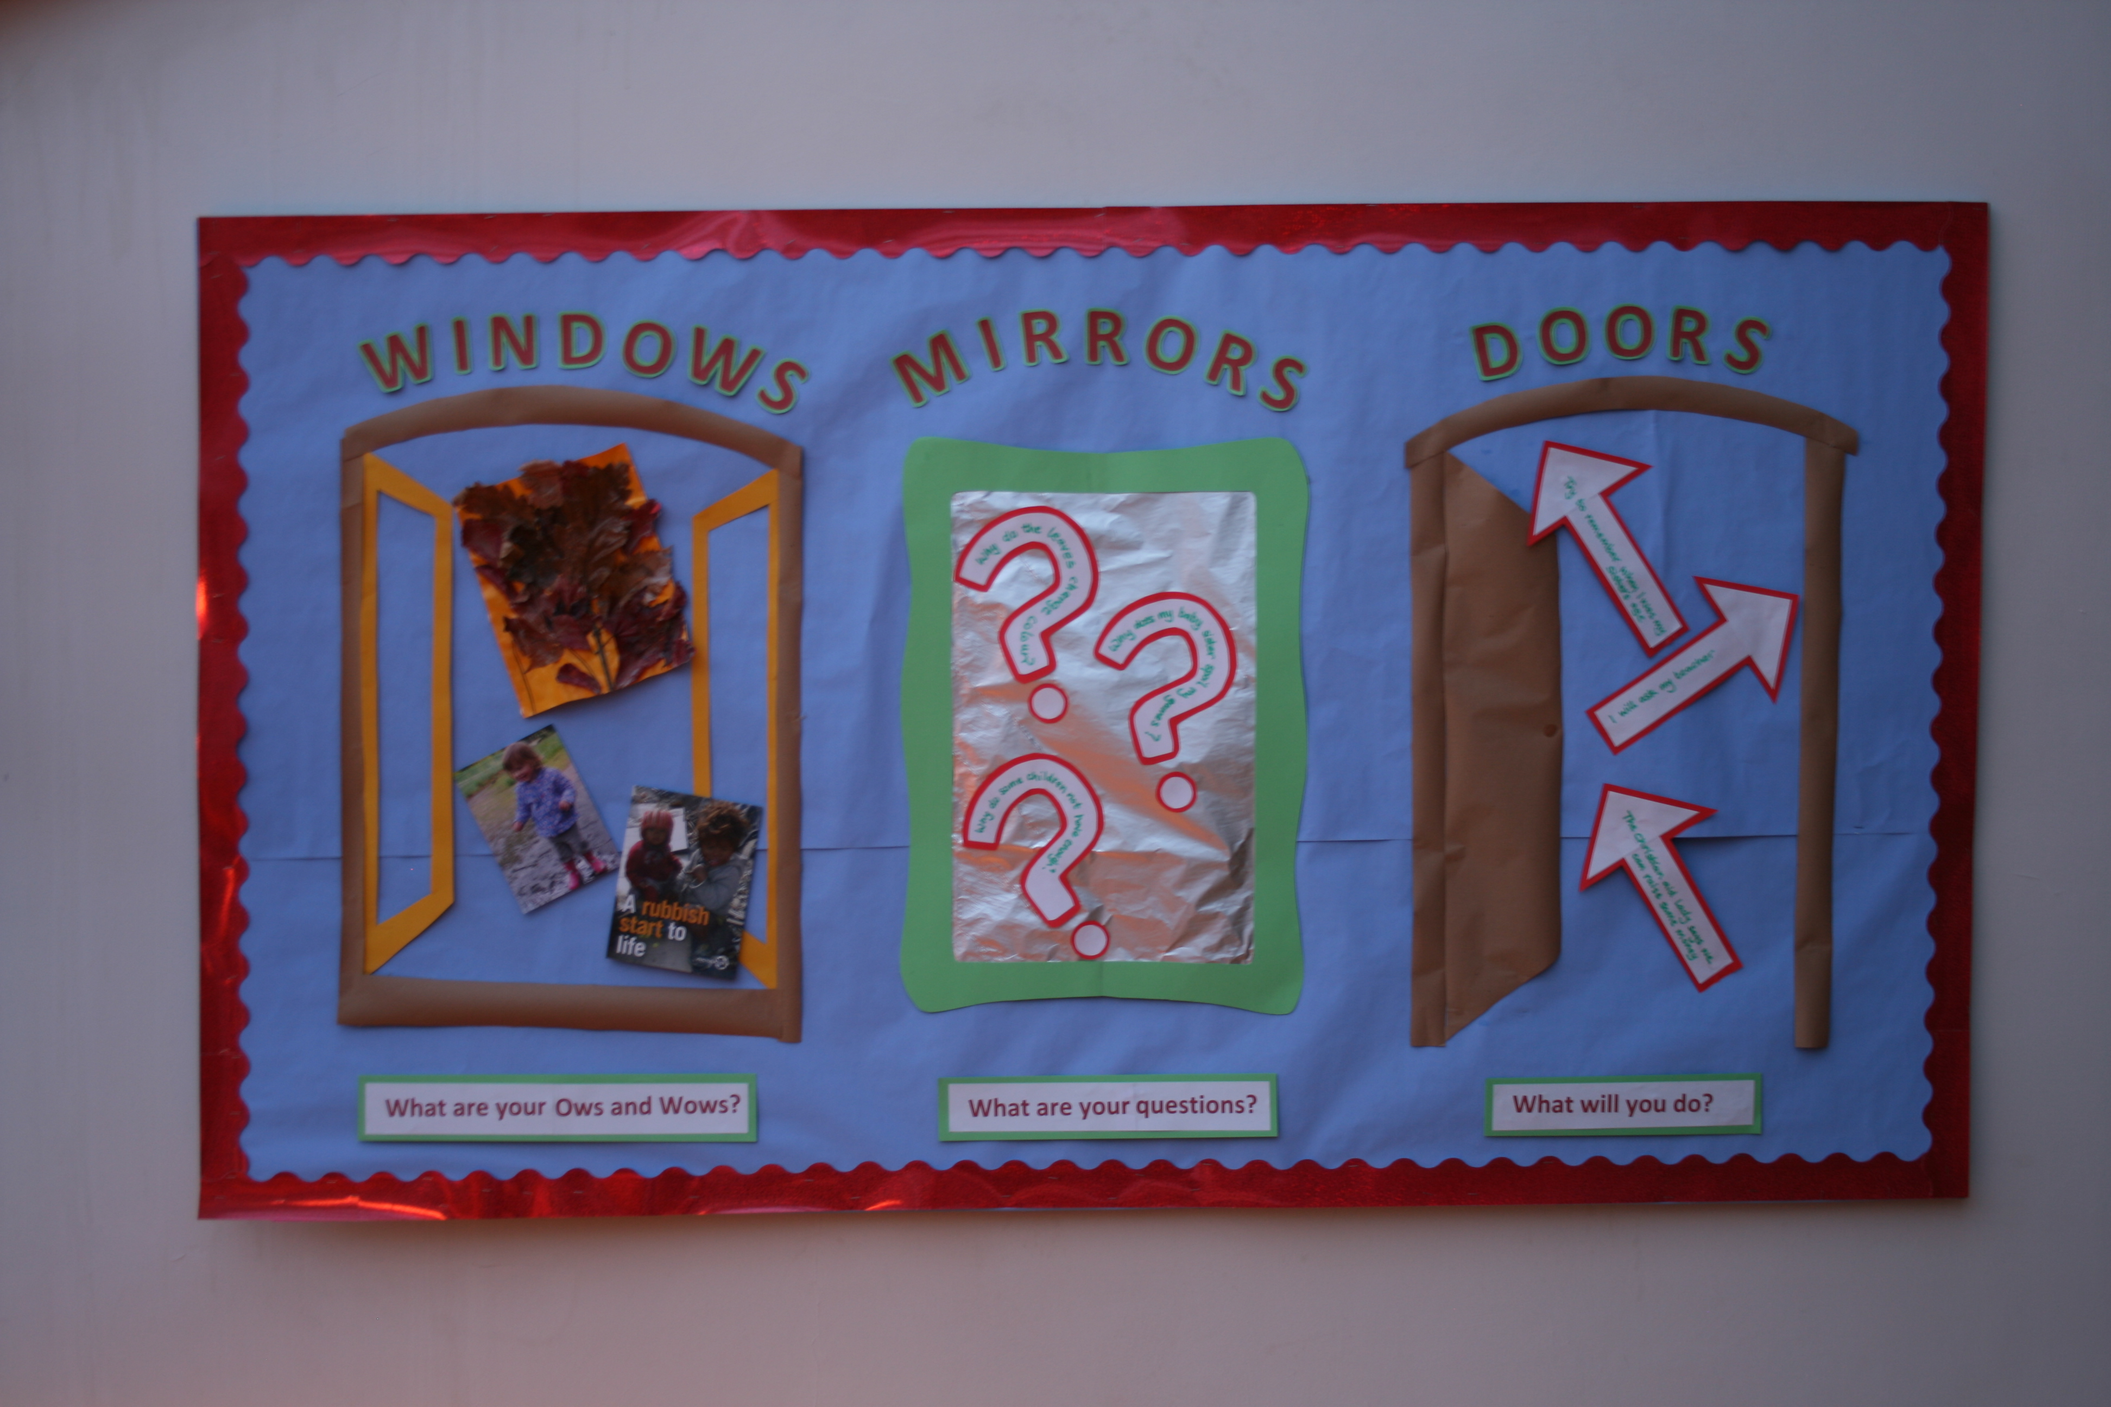
Explain to me how you use ‘windows, mirrors & doors’ in your learning.

Slide 12
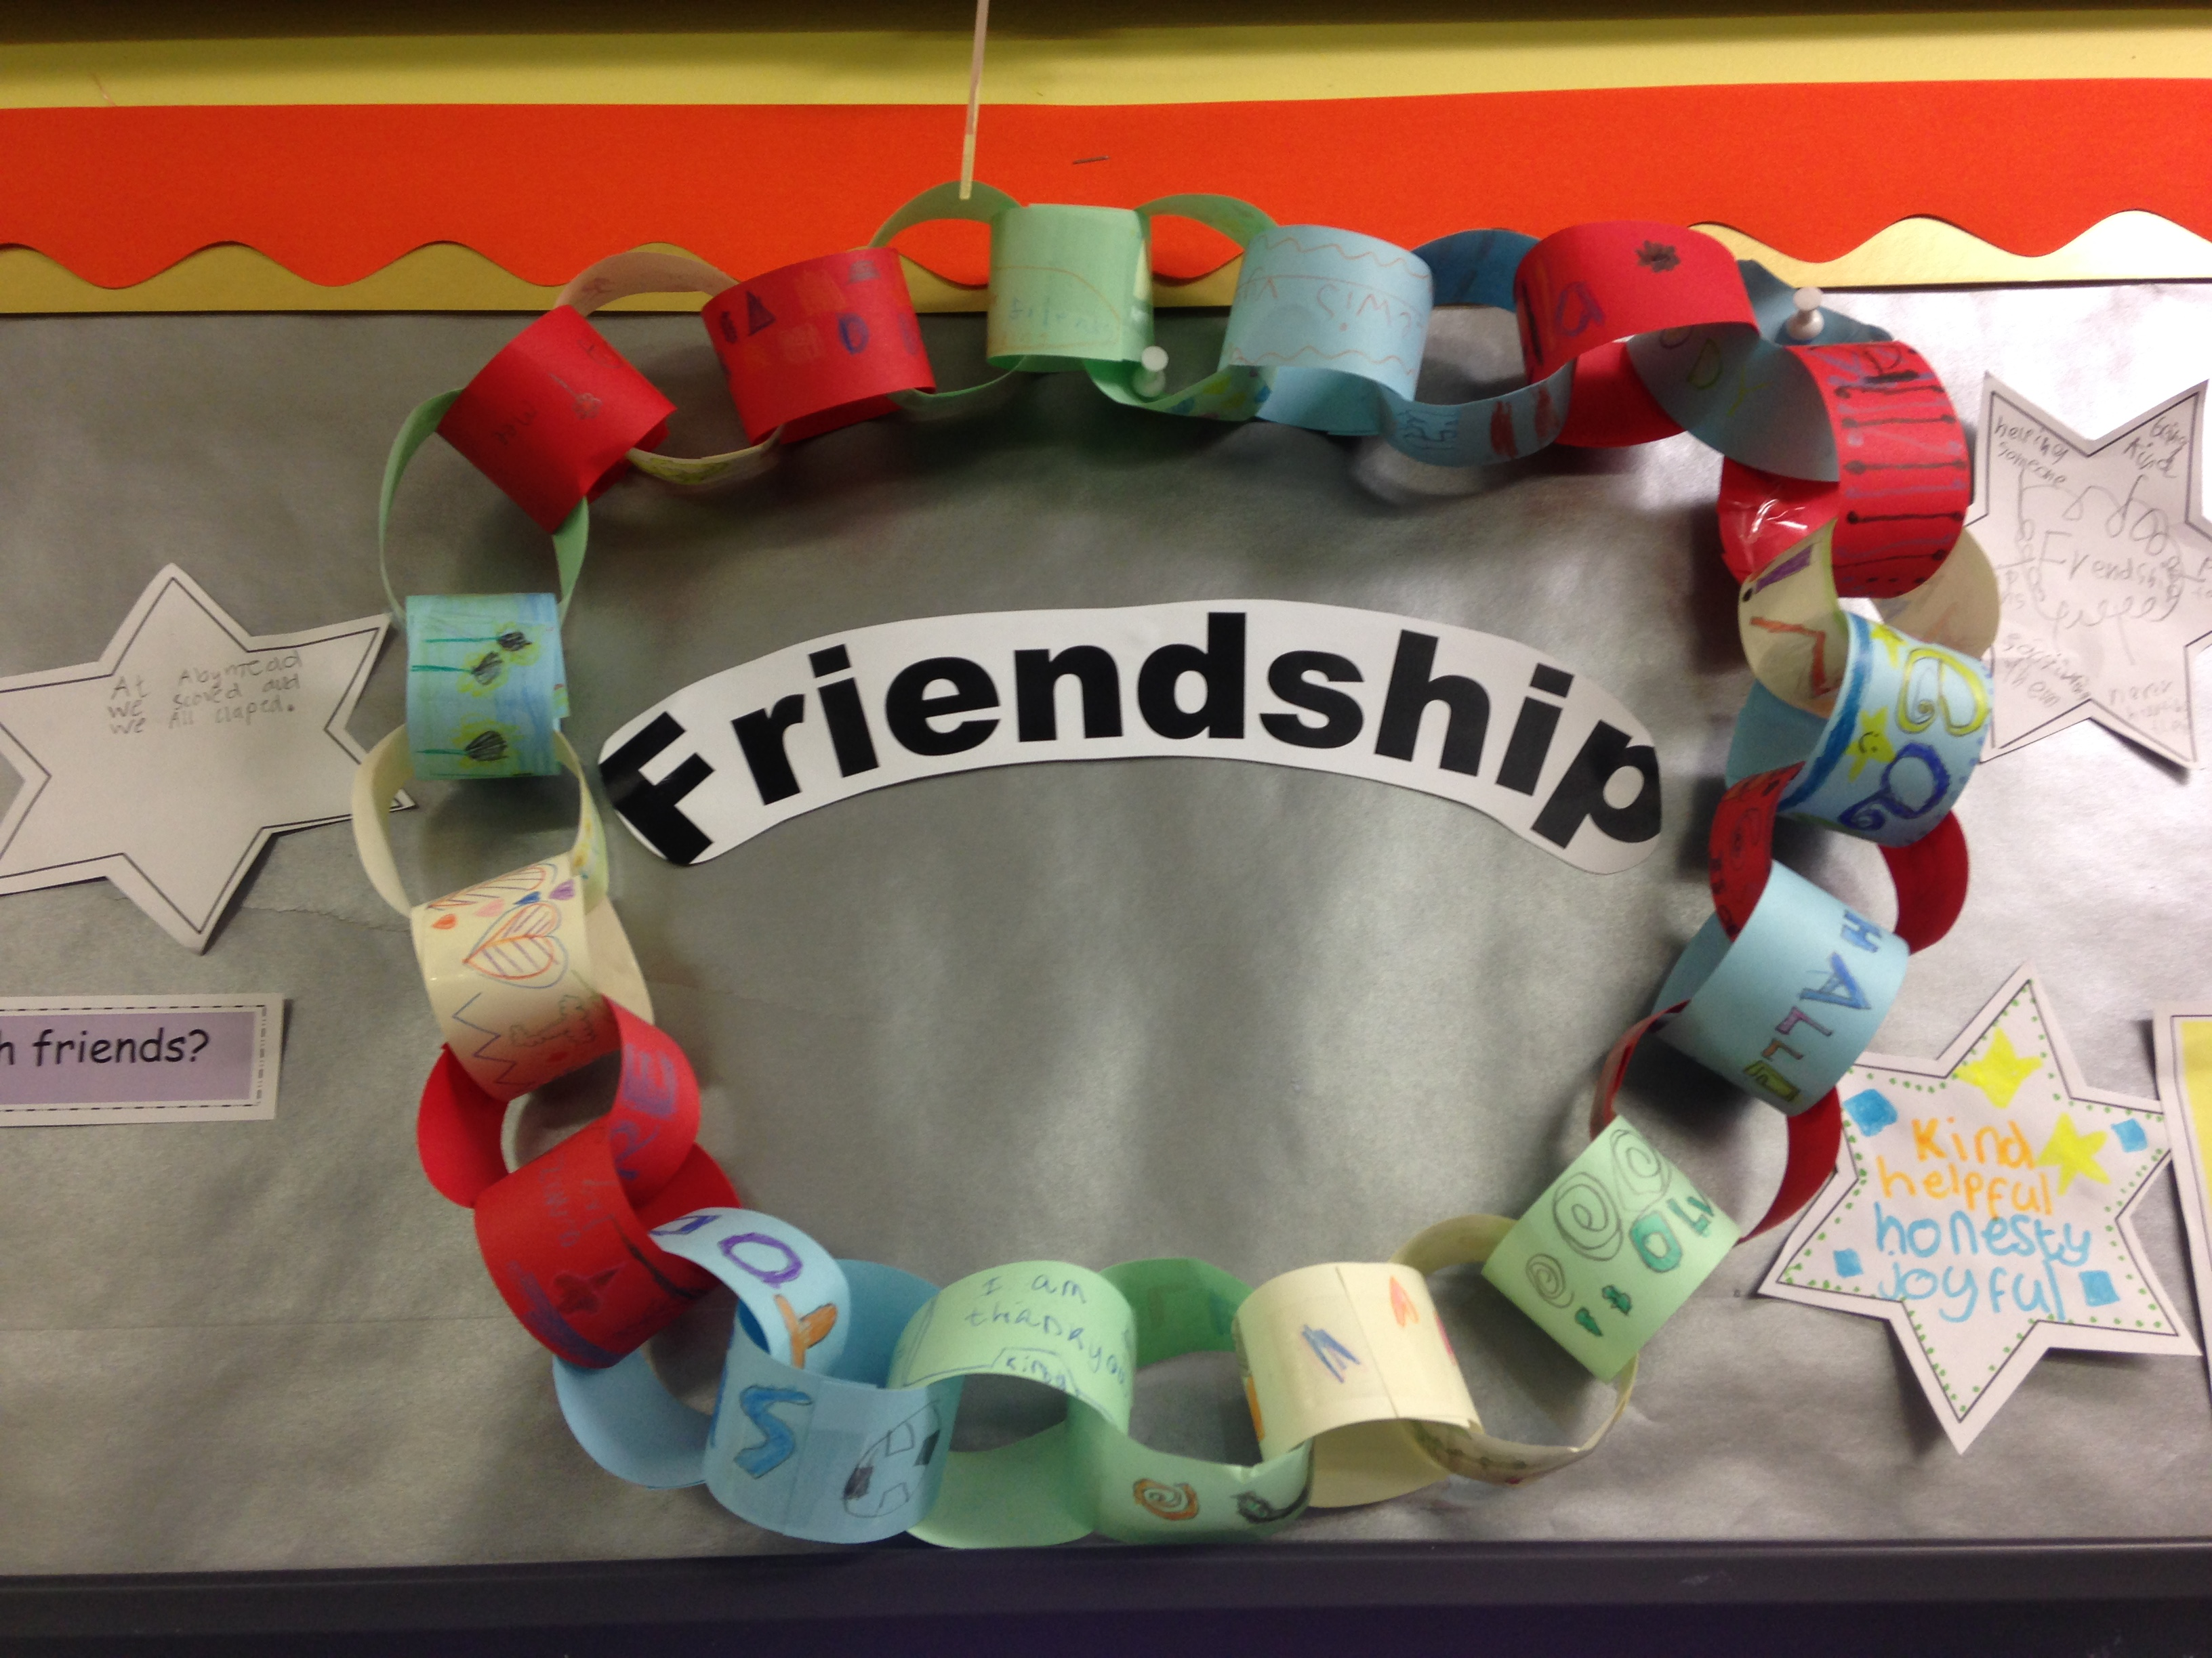
Supporting Christian Values
Tell me about your school’s Christian values.

Slide 13
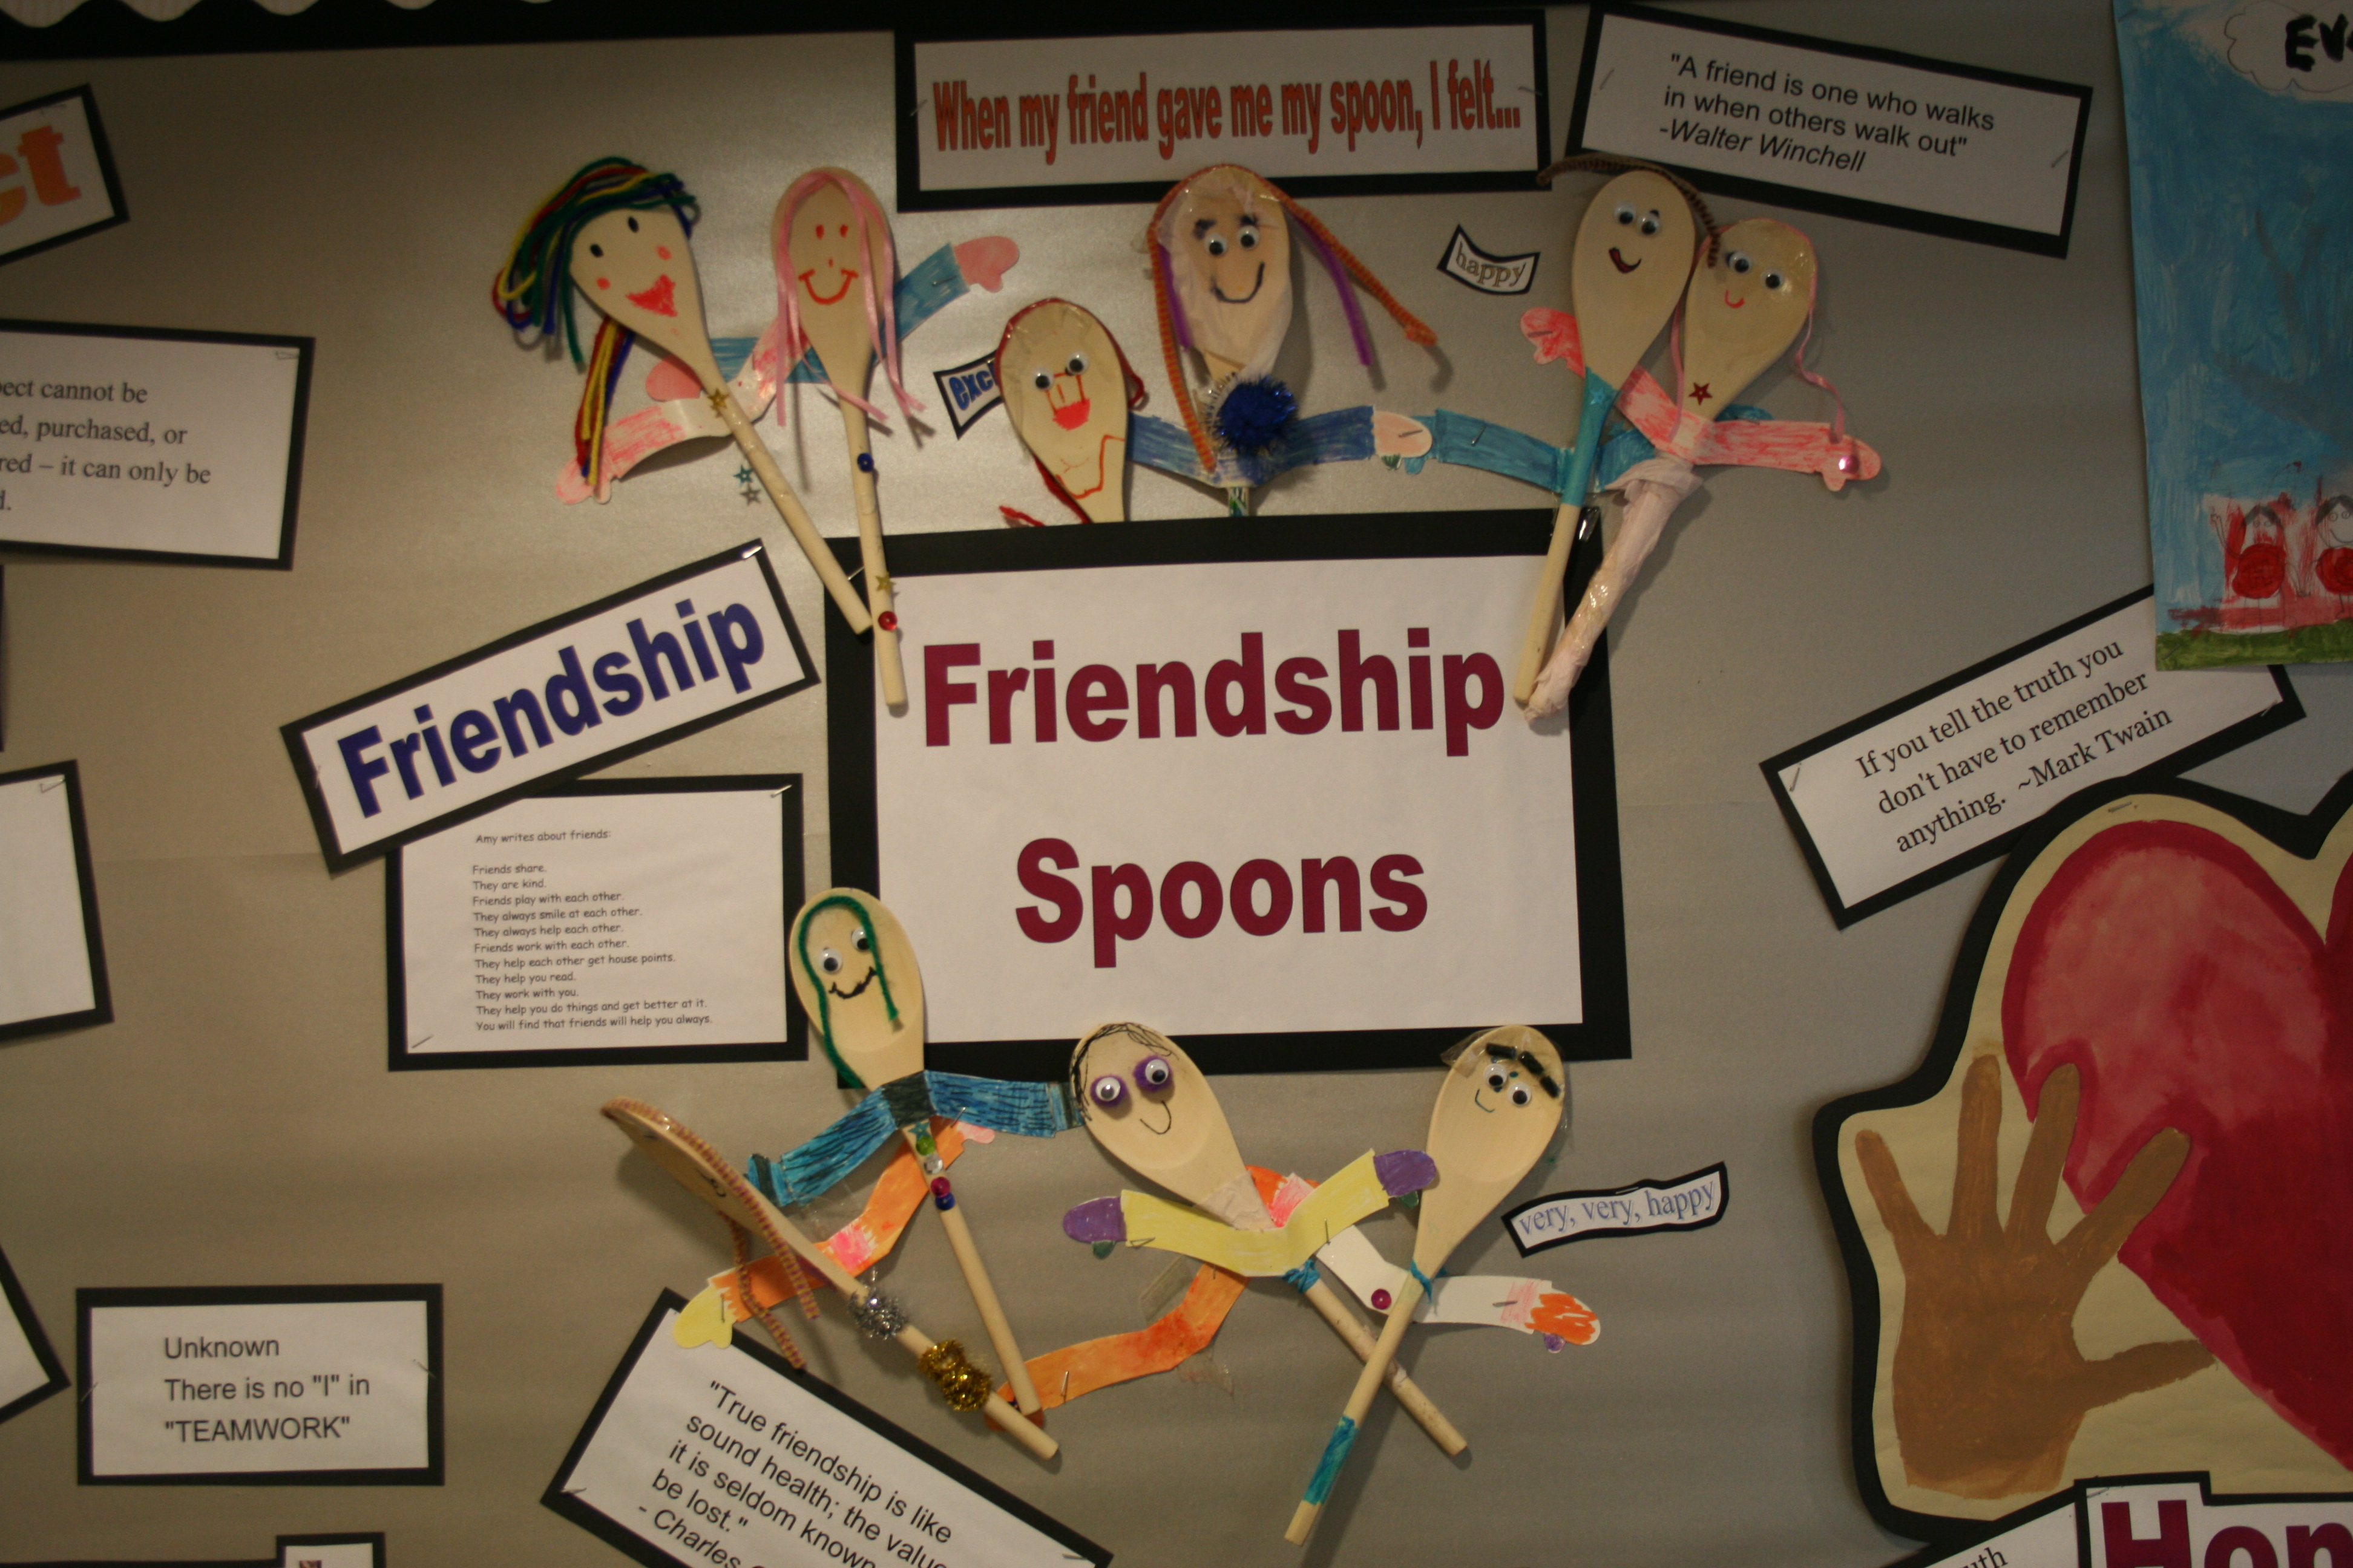
How does this display / learning wall help you to understand and celebrate your value this term?
How could it be even better?

Slide 14
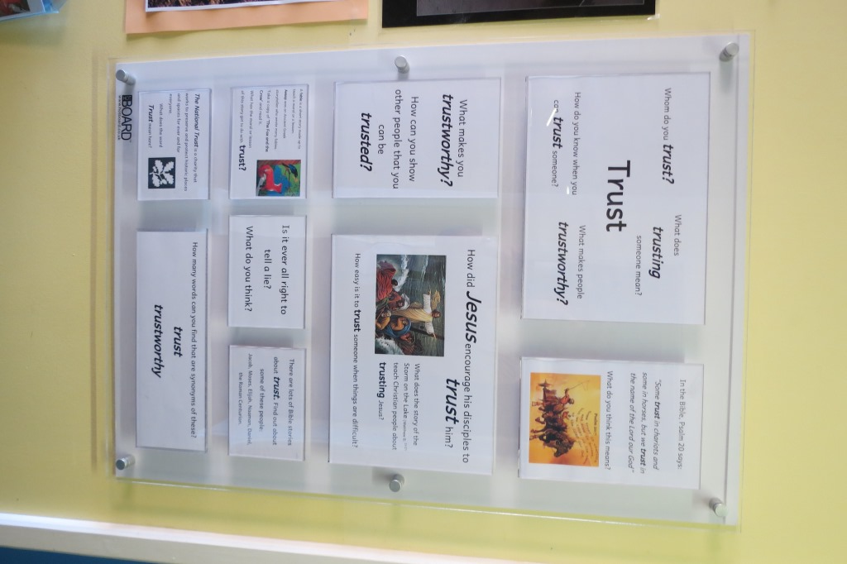
Can you remember anything you have seen around your school in the past that has helped you learn more about Christian values?

